Slide 1
Unit 6, Section 1
Solutions

Slide 2
What are Solutions?
Solutions are homogeneous mixtures
This means that the components blend together evenly but do not chemically combine
They DISSOLVE!

Slide 3
Parts of a Solution
Solutions have two parts:
1) The solute: In the mixture, this is present in lesser amount. It will dissolve into the solvent.
2) The solvent: In the mixture, this is present in the greater quantity.

Slide 4
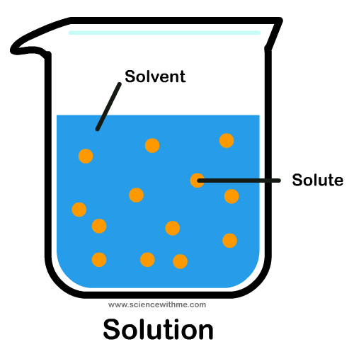

Slide 5
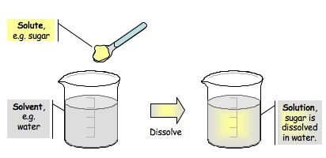

Slide 6
Solubility
Solubility is the ability of a solute to dissolve into a solvent
Not all solutes can dissolve, thus:
Soluble: can be dissolved
Insoluble: cannot be dissolved

Slide 7
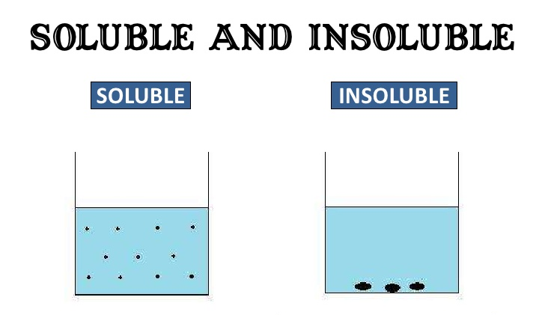

Slide 8
Amount of Solute
You can put a little or a lot solute in a solution
Concentrated Solutions: have a large mass of solute present in the solution
Dilute Solution: have a small mass of solute present in the solution

Slide 9
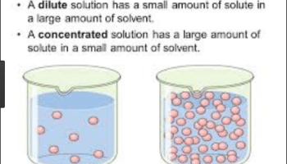

Slide 10
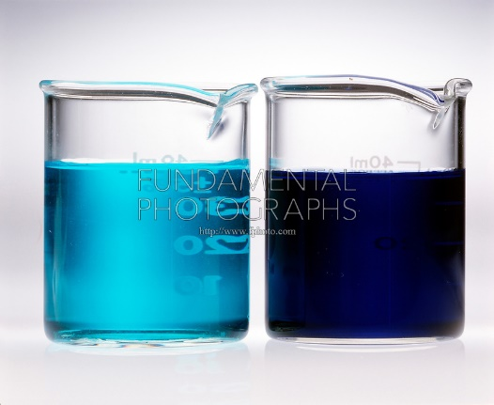
Which is the concentrated solution?

Slide 11
Concentration
Concentration is how much solute is present a certain amount of solvent or solution
There are various ways in express concentration
We learn about these in the next section!

Slide 12
Ways to Change Concentration
Increase the amount of solute
Decrease the amount of solvent

Slide 13
Water
Water is known as the universal solvent because more solutes dissolve in it than any other solvent.
This does not mean that everything dissolves in water!
Examples of things that dissolve in water: table salt, sugar, alcohol
Examples of things that do not dissolve in water: oil, chlorophyll

Slide 14
How Water Dissolves its Solutes
The water molecules (also known as water particles) dissolve SALTS differently than SUGARS
SALT: Water disassociates the cations (+) from the anions (-)
SUGAR: Water pulls the sugar particles off of the big crystal sample

Slide 16
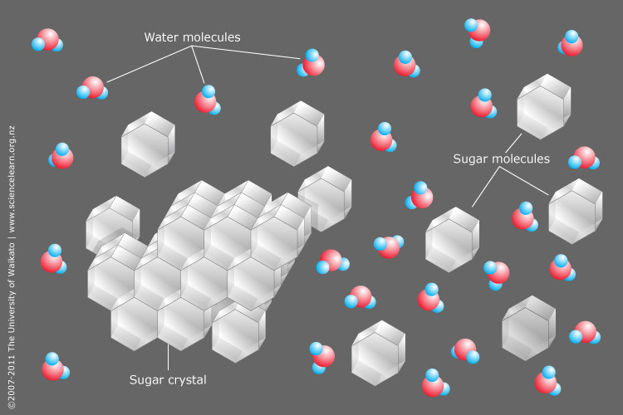
SUGAR

Slide 17
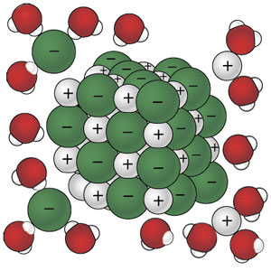
SALT

